Slide 1



TRACING ACTIN FILAMENT
NINA NIKITINA 12/23/2020

Slide 2
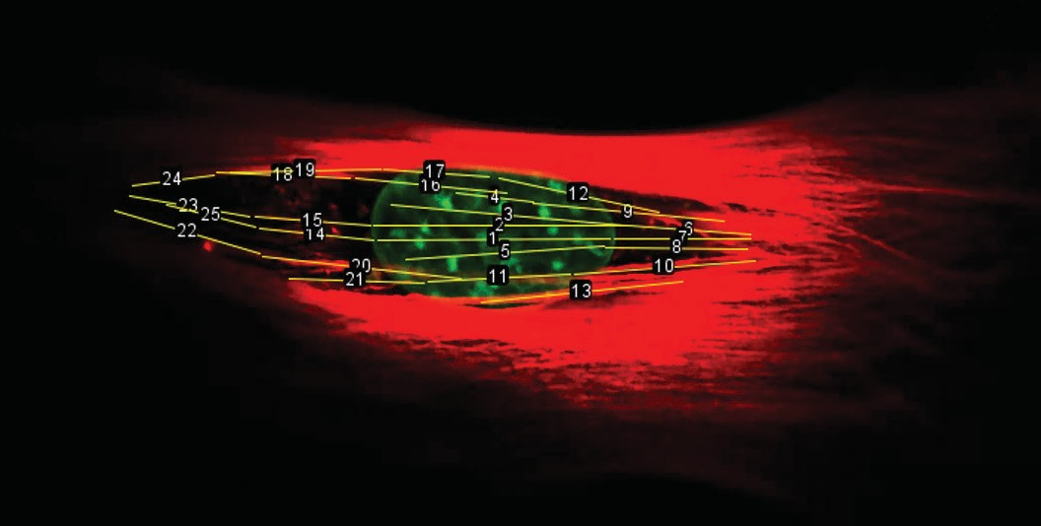
TRACING ACTIN FILAMENT

Slide 3




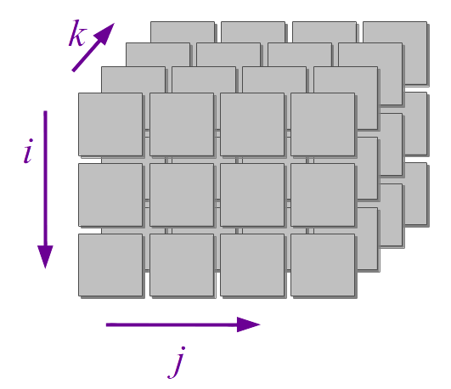
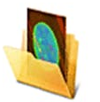
ALGORITHM
z = layers
y
x
CZI DATA
3D ARRAY

Slide 4
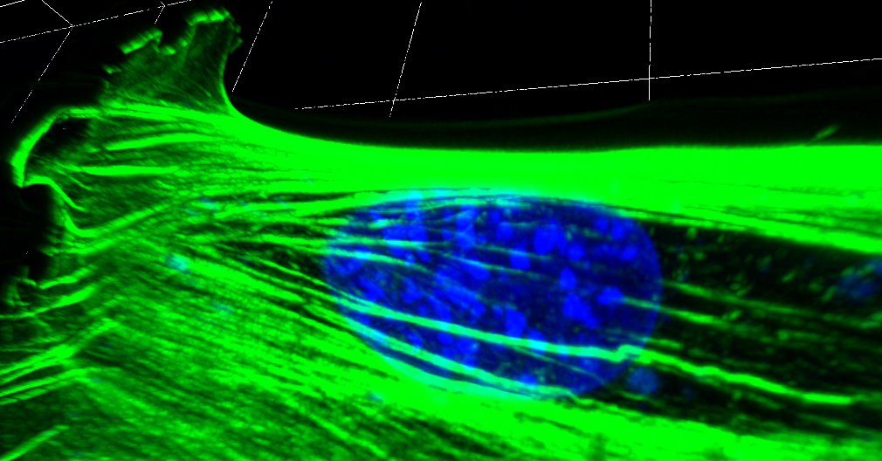
TRACING ACTIN FILAMENT
TOP

Slide 5
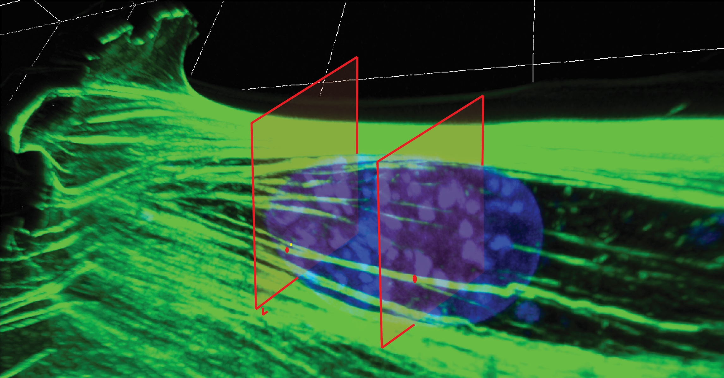
TRACING ACTIN FILAMENT

Slide 6
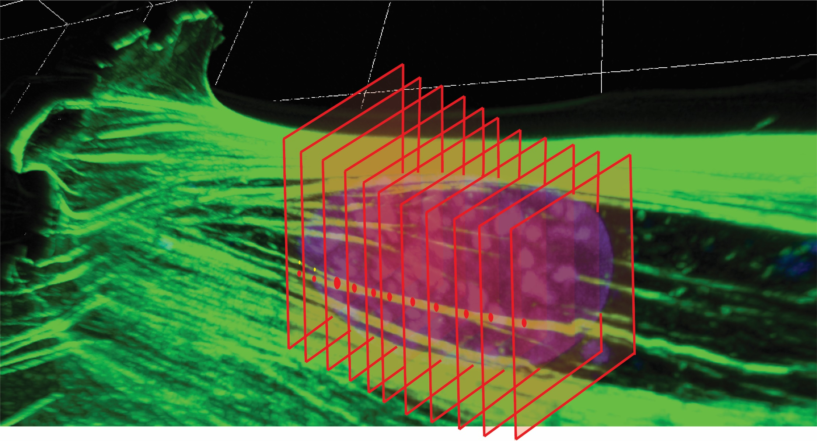
TRACING ACTIN FILAMENT

Slide 7
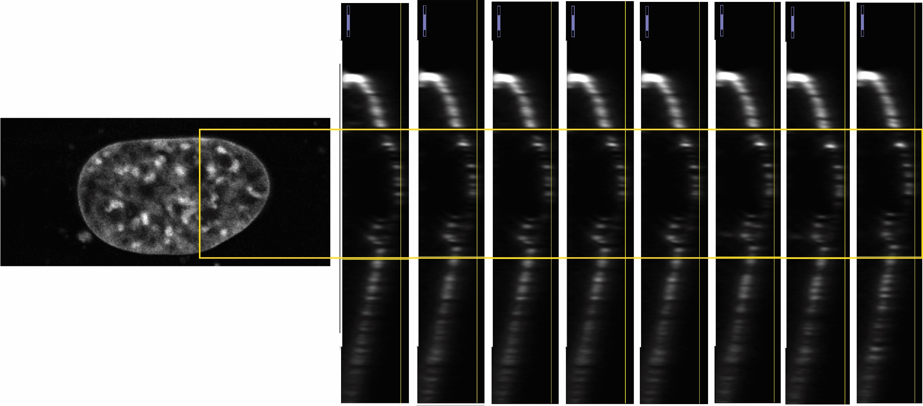
TRACING ACTIN FILAMENT: LABELING OpenCV or UNET

Slide 8
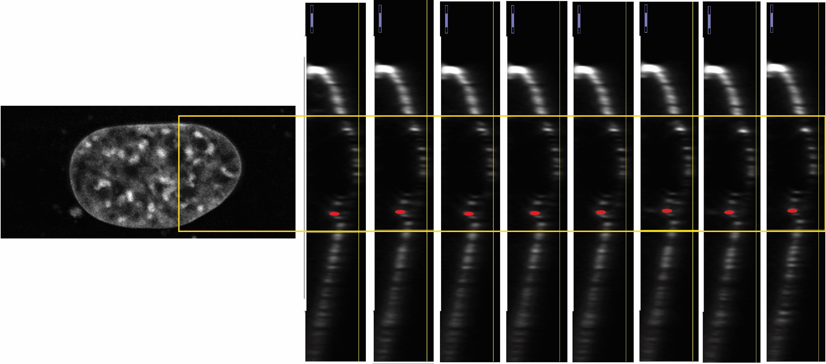
TRACING ACTIN FILAMENT
Slice # | x | y | z | Surface area
1 | X1 | Y1 | Z1 | S1
2 | X2 | Y2 | Z2 | S2
… | …
n | Xn | Yn | Zn | Sn
x, y, z – coordinates from a center of the nucleus

Slide 9
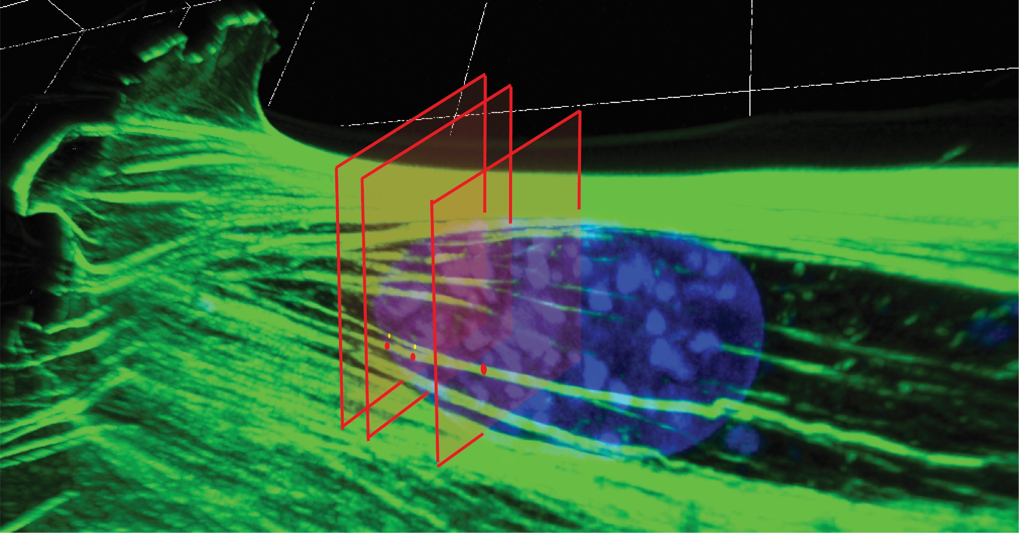
Questions: How to trace "fork" actin?

Slide 10
Questions: What outcome data should this program produce? What does Madison need to build a model?
Slice # | x | y | z | Surface area
1 | X1 | Y1 | Z1 | S1
2 | X2 | Y2 | Z2 | S2
… | …
n | Xn | Yn | Zn | Sn

